Slide 1


Bringing employment first to scale Integrating the evidence for a comprehensive model for change
APSE June, 2015

Slide 2






Slide 3
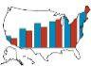
Employment and Day Supports IDD Agencies: Nation
607,959
113,271
Source: ICI National Survey of State IDD Agencies

Slide 4
Non-work is growing CRPs: 2002 to 2010
Source: 2010-2011 Survey of Community Rehabilitation Providers, ICI

Slide 5
Participation in integrated employment services varies widely
Source: ICI National Survey of State IDD Agencies

Slide 6
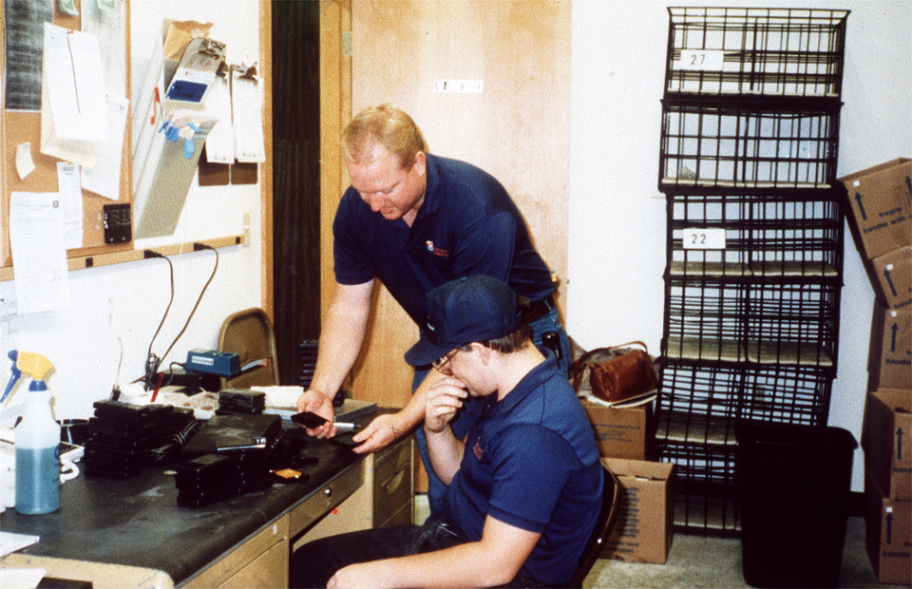
Notes:
Ron - Cablevision

Slide 7
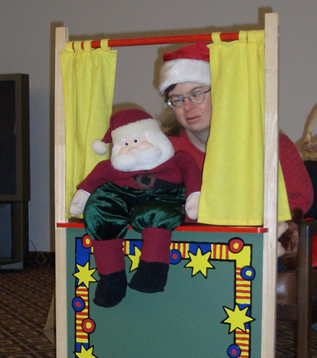
Notes:
Dusty’s Puppets

Slide 8



Slide 9
Holistic Perspective
Individuals & Families
Employment Supports
Individual Employment Outcomes
Community Rehabilitation Provider Practices
State Policy & Strategy

Slide 10
Holistic Perspective
Community & Labor Market
Workplace
Individuals & Families
Employment Supports
Individual Employment Outcomes
Community Rehabilitation Provider Practices
State Policy & Strategy
Federal Policy

Slide 11
Collaborative Design
Individual & Family Engagement
Employment Support Practices
Organizational Transformation
State Systems
Project Partners
Institute for Community Inclusion
SABE
Arc
SCAN 360
University of Minnesota
Elsevier
APSE
Arc
APSE
NASDDDS
University of Minnesota
Advisors
National Advisory Panel
NASDDDS
National Advisory Panel
SABE
National Advisory Panel
National Advisory Panel
APSE, Arc
Dissemination
NDSC
SLN
AUCD
NACDD
AAIDD
Univ of Vermont
Easter Seals
AUCD
NACDD
AAIDD
Univ of Vermont
Easter Seals
AUCD
NACDD
AAIDD
Univ of Vermont
AUCD
NACDD
NDRN
NDSC, AAIDD

Slide 12
ICI Affiliated Projects
Research & Evaluation
Systems Change
Access to Integrated Employment AIDD
State Employment Leadership Network Member funded
RRTC on Advancing Employment
Employment Consultants’ Role NIDRR: RRTC/CL
Partnerships in Employment Systems Change / AIDD
Community Life Engagement / NIDRR
Training
Employment Learning Community AIDD
College of Employment Services
RRTC Demand Side Strategies / NIDRR
Job-Driven Vocational Rehabilitation TA Center
RSA
Florida EmployME First Florida DD Council
ExploreVR.org
NIDRR
RTAC VR Program Management / NIDRR
Service
AT Programs Data Center
RSA
ICI Employment Services
DDS, MRC, Schools

Slide 13
Strand 1: Individual and family engagement
Challenges
Expectations around employment are important, but…
Are trainings the only way to go?

Slide 14
What we know
Young adults with IDD expect to work
Families shape expectations around employment
Families provide logistical support
Family knowledge around employment is limited
Knowledge-based training can help
Systems have a hard time interacting with families

Slide 15

Strand 1•Individuals and Families
Employment is a lifelong conversation and information and support are available on a “just in time” basis
Types and pathways for information and support are effective and accessible

Slide 16
Approach
Scoping Literature
Online/In-person Focus Groups
Develop and test a strategy that
Engages individuals and families early and often
Focuses on the best ways to provide just the right amount of information at just the right point in time

Slide 17
Community Conversation
If you could change one thing about how systems interact with families, what would it be?
If you could change one thing about how your work interacts with families, what would it be?

Slide 18
Strand 2 • Improving employment supports: Achieving consistent implementation of best practice
“…Regardless of the job seeker’s level of motivation, skill, experience, attitude, and support system, his or her ability to get a job will often depend on the effectiveness of employment specialists…
Simply stated, if (the employment specialists) are good, job seekers get jobs. If they are not, the barriers to employment for job seekers can become insurmountable…”
(Luecking et al., 2004, p. 29)

Slide 19
What we know
Extensive literature on effective supports practices
35,000 employment consultants, nationally (estimated)
Majority of employment consultants assisting up to 5 job seekers with IDD getting jobs per year
Limited implementation of best practice
Notes:
Estimated 500,000 adults with IDD receiving services from community rehabilitation programs (CRPs)
Estimated 5-6,000 CRPs, nationally each on average with 6 ECs
Effective support practices: supported employment, customized employment, discovery, person-centered career planning, natural support, demand side job development, work incentive planning

Slide 20
…for example

Slide 21
…for example
Percentage of employment consultants performing job search activities for most or all job seekers (N=163; 28 states)
Notes:
Decisions to meet the unique individual circumstances, preferences, and support needs of job seekers
Most effective for increasing the number of job seekers who find jobs, and find jobs that yield better wages, and work hours?
Benchmark: e.g. duration of discovery/assessment; number of employers contacts; number of interviews

Slide 22
Multi – element interventions improve outcomes
Baseline
Post Baseline
Intervention
⬆7.8 jobs (+2.3)
5.5 jobs
Training & Mentorship
Control
⬇4.1 jobs (-1.1)
5.2 jobs
Higher Hourly earnings: + $1 (p<.10)
Higher weekly work hours: + 6.7 (p<.05)
Butterworth et al, 2012

Slide 23
Challenges
Anecdotal vs. evidence-based
What are key benchmarks?
How to measure and coach the implementation of promising practices?
Holistic approach
Notes:
Decisions to meet the unique individual circumstances, preferences, and support needs of job seekers
Most effective for increasing the number of job seekers who find jobs, and find jobs that yield better wages, and work hours?
Benchmark: e.g. duration of discovery/assessment; number of employers contacts; number of interviews

Slide 24
Strand 2 • Employment Supports
A flexible model that accounts for variations in individual preference and need
A scalable approach to improving employment outcomes

Slide 25
What’s the big goal
Track implementation
Refine
Training and mentoring

Slide 26
Approach
Study 2.1. Learning from outstanding, employment consultants:
Interviewing 16 employment consultants, job seekers, family members, and supervisors

Slide 27
Study 2.2. Improving the implementation of effective employment support practices:
Randomized trial 100 employment consultants
online training
data-based performance feedback
peer supports

Slide 28
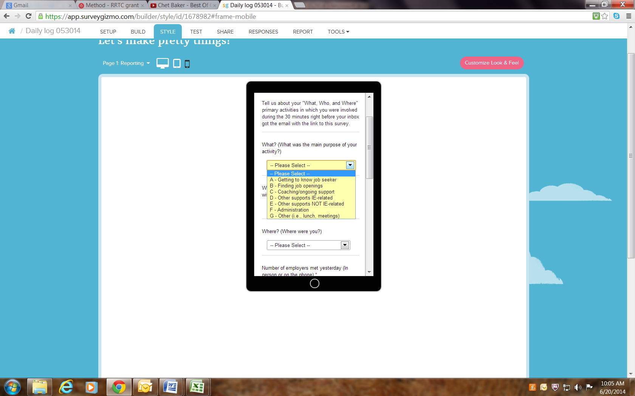
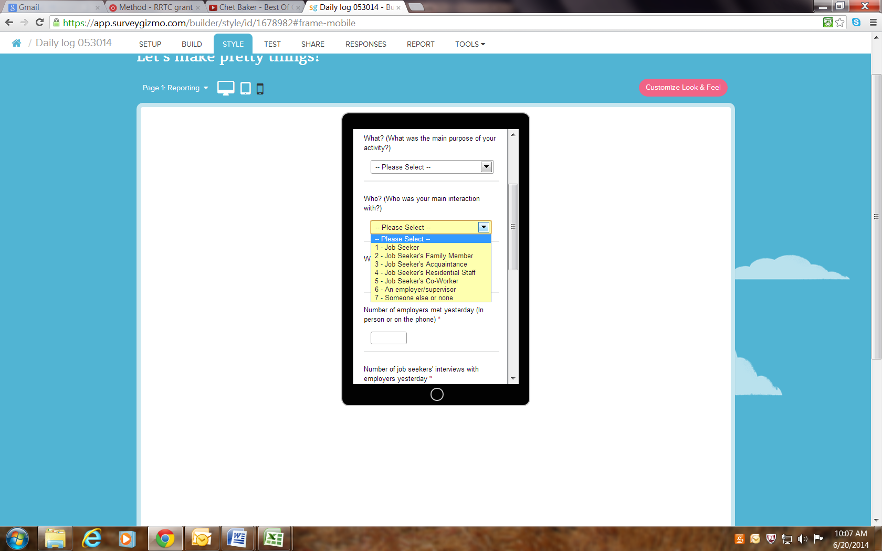
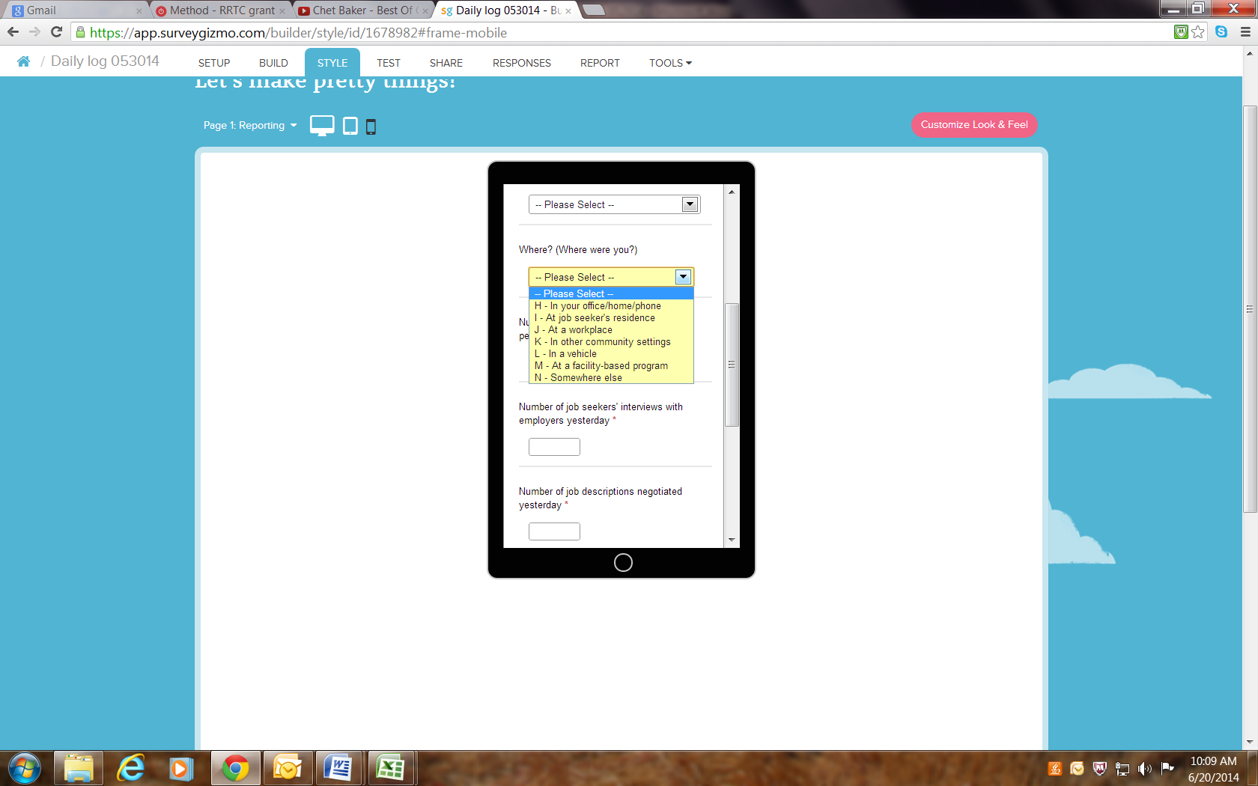
Activity Log for Smart Phone

Slide 29
Community conversation
What makes an employment consultant effective for you?
What key benchmarks would you watch?
Time spent getting to know job seekers
Time spent networking
Time spent interacting with the business community
Time with family members
????
How would you track progress in implementing effective employment support practices?
Notes:
Outcomes: Higher employment rate; Higher wages and more work hours; Job retention; Career advancement

Slide 30
Strand 3 • Community Rehabilitation Providers
To understand CRP characteristics that promote transformation
Provide tools to CRPs to enable change
Model for supporting organizational restructuring in an efficient/scalable way

Slide 31
Strand 4: Aligning policy and practice at the state level across agencies
National policy
WIOA, CMS guidance, DOJ/Olmstead
Growth of Employment First initiatives
BUT
Inconsistent and competing priorities
Integration across systems

Slide 32
What we know
Systems coordination matters
Vocational Rehabilitation,
Intellectual and Developmental Disability
Education
Expansion of Employment First policies
44 states with initiatives
32 states with policy or directive

Slide 33
What we know
Policy change does not guarantee more will be employed
For change to be sustainable…
it must be occur with a comprehensive approach, and
we know many of the elements that must be included

Slide 34
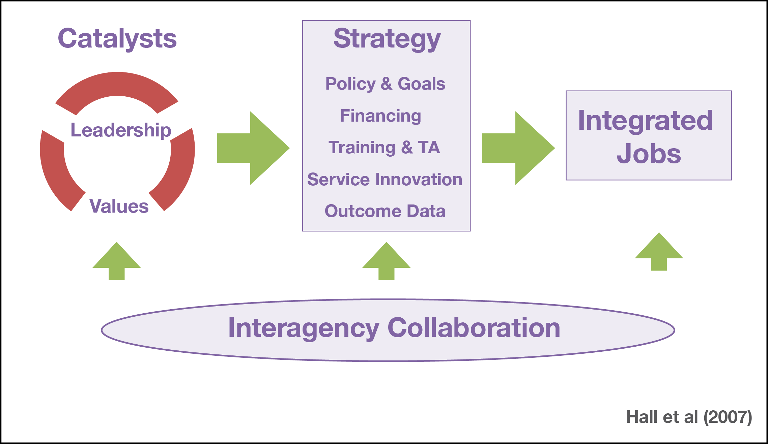
High-Performing Framework
Notes:
34
Catalysts
Is everyone on the same page
Who owns it?
Clear goals
Strategies:
Is implementation and investment consistent with the goals and values?
Facilitators
Are we developing key relationships?
Is there opportunity for local innovation and ownership?

Slide 35
Strand 4 • State Policy and Practice
Understand the essential components of high performing cross-agency employment service systems
Systems intentionally align practices with a priority for employment and bring components to scale

Slide 36
Approach
Secondary data analyses
Case studies
Policy analyses

Slide 37
Policy Strand: Systems outcomes and characteristics
Employment system scales
IDD, VR, and K-12 data
Research Questions
What is the relationship between state employment system characteristics and employment outcomes ?
How do specific Employment First efforts intersect?

Slide 38

Policy Strand: Secondary Analysis
National Core Indicators
13,000 people with IDD
36 states
Research Questions
Relationship between individual characteristics and employment outcomes?
Effects of setting on inclusion, choices, relationships, etc.?
How do specific policies relate to outcomes?

Slide 39
Policy Strand: Policy analyses
5 priority areas – what are the biggest issues facing state IDD administrators?
E.g. case management guidelines, CMS expectations re: community settings
Case examples of promising state strategies and practices
Products administrators can use

Slide 40
Policy Strand: State IDD agency policy and practices: 5 policy anayses
Service definitions: Changing CMS rules and expectations on community and employment
Case management guidelines and strategies
Managing service quality and fading of supports
Interagency collaboration with VR and Education
Engaging individuals and families

Slide 41
Community Conversation
What are the 3 most critical change priorities in your state?

Slide 42
Bringing change to scale
What is missing from this framework?
How does your state connect policy to
Individuals and families?
Employment consultants?
What coalitions exist in your state? Who owns the change process?
Unanswered questions?

Slide 43
www.ThinkWork.org

